Slide 1
Chapter 6: Creational Design Patterns
Session II: Factory Method

Slide 2
Session’s Agenda
Creational Patterns in Detailed Design
Factory Method Design Pattern
  Java Example
  C++ Example
Null Object Design Pattern
Benefits of Factory Method
What’s next…

Slide 3
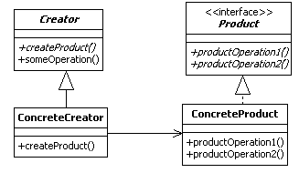
Factory Method Design Pattern
The Factory Method design pattern is a class creational pattern used to encapsulate and defer object instantiation to derived classes.
According to the GoF, the intent of the factory method is to [1]
  Define an interface for creating an object, but let subclasses decide which class to instantiate. Factory method lets a class defer instantiation to subclasses.
Products need to obey the Product interface!
Factories need to obey the Factory interface!
Product
Classes
Creator
Classes

Slide 4

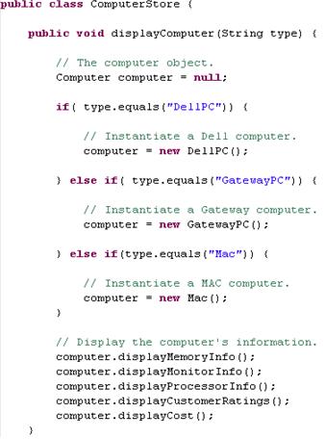

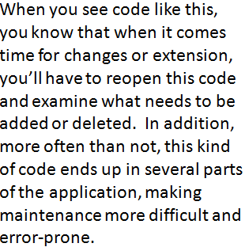
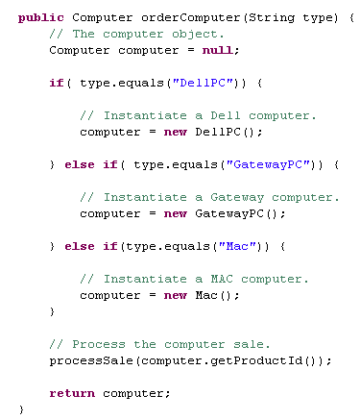
Factory Method Example
Store 1
Store 2
Consider this code, which handles all computers from stores #1 and #2. What’s wrong with it?
Java code
Remote Store Manager’s Station
This code would have to support all types of computer in all sites!
Let’s take a closer look in the next slide…

Slide 5
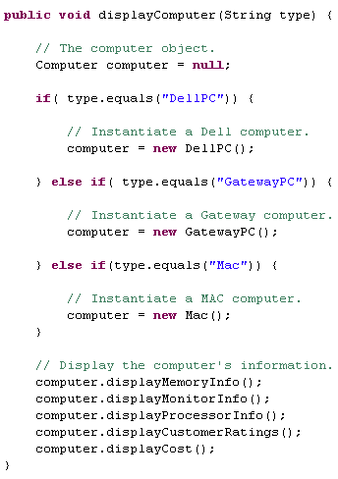
Factory Method Example
This code is not closed for modification. If a new computer is added to the inventory of store #1, we have to get into this code and modify it for all other stores!
Design Principle:
Encapsulate what varies!
This is what varies. As the computer selection changes over time (for all computer stores), you’ll have to modify this code over and over.
Important:
By coding to an interface, we can insulate ourselves from future changes!
This is what we expect to stay the same.
Let’s see how the Factory Method can be used to solve this problem…

Slide 6
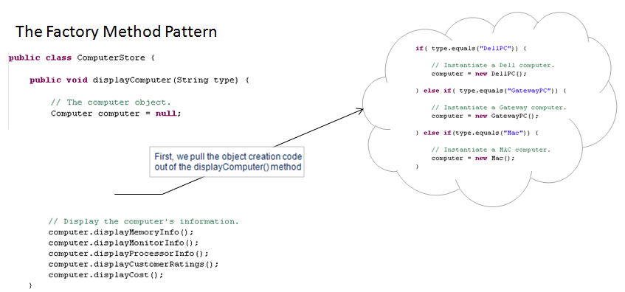
Factory Method Example

Slide 7
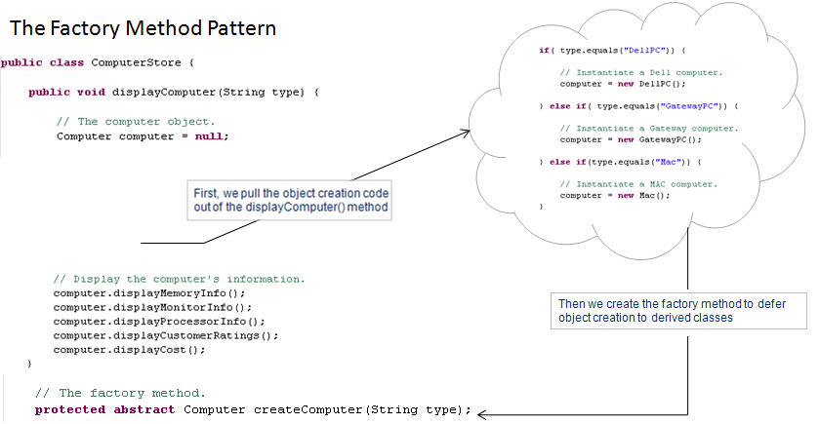
Factory Method Example
Notice that this is an abstract method!

Slide 8
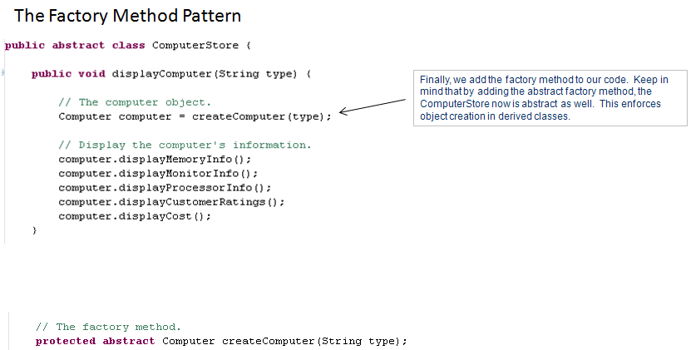
Factory Method Example
Notice that this is an abstract method!

Slide 9

Factory Method Example
Consider an information system for a chain of Computer Stores. The chain is currently composed of two sites and the manager wants to have a centralized software that manages all two sites. Mainly, the manager wants this centralized system to keep track of computer sales and display computer information for all sites. Not all sites carry the same computers and new sites could be added in the future, therefore support for computers should be site-specific!
Remote Store Manager’s Station
Manager logs on to this computer to view products from all sites.
It is possible that other sites carrying different computers could be added in the future
Computer Store 1
DELL
Computer Store 2
DELL
Inspiron
Latitude
HP
MAC
MAC
Mac Book Air
Mac Book Pro

Slide 10
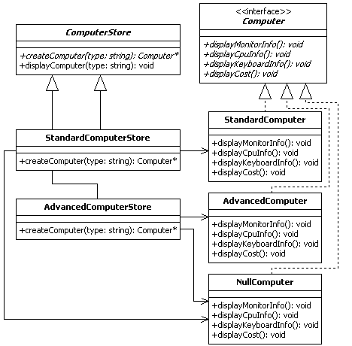
Factory Method Design Pattern Example
Products need to obey the Product interface!
Factories need to obey the Factory interface!
Creator
Classes
Product
Classes

Slide 11

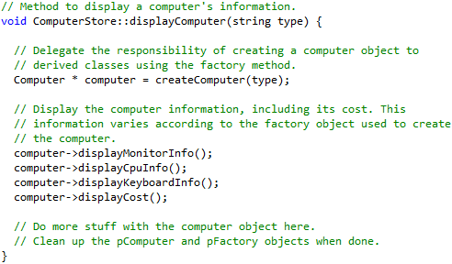
Factory Method Example
Sample code for the displayComputer (…)method:
Factory method!
Optional parameter
This is what we expect to stay the same.

Slide 12
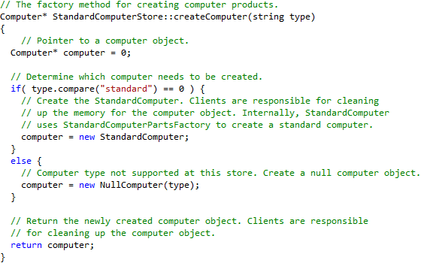


Factory Method Example
Factory method implementation for standard computer store
Optional parameter
Rarely a computer store will carry only one computer!
A generic standard computer
We use the optional parameter to support computers that may be carried in the future by the standard computer store
Let’s see how to support new standard computers…

Slide 13
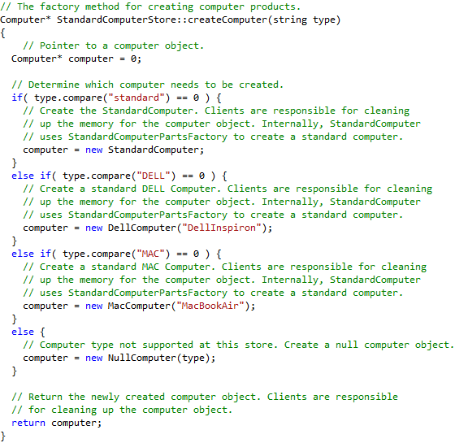
Factory Method Example
The standard computer store now carries Dell Inspiron and Mac Book Air computers
Important:
Notice that these changes are independent from what happens in the AdvancedComputer Store!

Slide 14
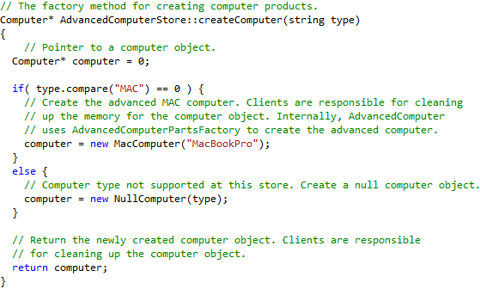

Factory Method Example
Optional parameter
Currently, the advanced computer store only carries Mac Book Pro computers
Hopefully, by now, you are able to see how the pattern works to localize changes and support the addition of future computers with minimal impact!

Slide 15
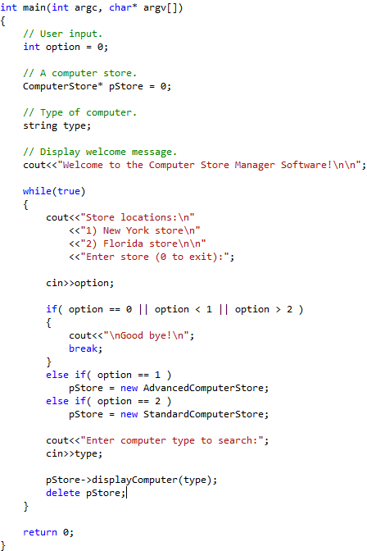
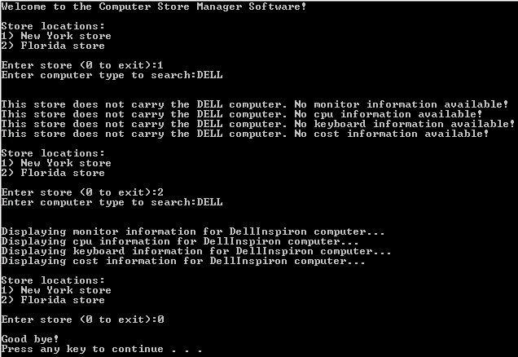
Factory Method Example
Sample output
Just enough code to demonstrate the Factory Method in action!

Slide 16
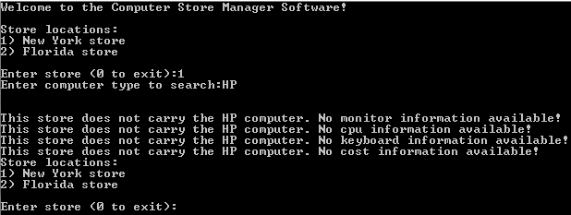
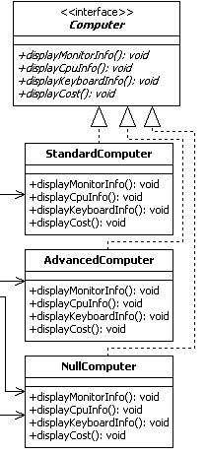

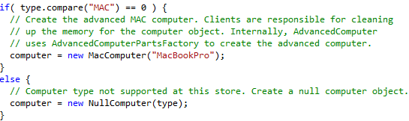
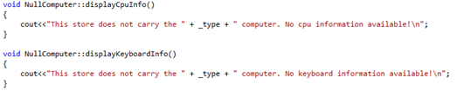
Factory Method Example
The Null Object Pattern!
Did you notice this NullComputer class?

Slide 17
The Null Object Pattern Example
The Null Object Pattern!
With this pattern, we treat invalid inputs as objects, therefore allowing us to treat them as other valid expected objects!

Slide 18
Factory Method Design Pattern
Steps for designing with the Factory Method:
  Identify and design the product interface (e.g., Computer)
  Identify and design the concrete products that realize the interface from step 1 (e.g., StandardComputer, AdvancedComputer, DellComputer, etc.)
  Design the factory interface (e.g., ComputerStore), which contains one abstract factory interface method for delegating product creation to derived classes.
  Design one or more concrete factories for each product identified in step 2.
  Associate each factory from step 4 with its respective product from step 2.
Benefits of the Factory Method pattern
  Separates code from product-specific classes; therefore, the same code can work with various existing or newly created product classes.
  By separating the code, development becomes efficient, since different developers can work on the different parts of the project at the same time.
  By separating the code, it becomes easier to reuse and maintain specific parts of the code.

Slide 19
What’s Next…
In this session, we continued the discussion on creational design patterns, including:
  Factory Method
In the next sessions, we will finalize the presentation on creational design patterns. Specifically, we will cover:
  Builder
  Prototype
  Singleton

Slide 20
References
[1] Gamma, Erich, Richard Helm, Ralph Johnson, and John Vlissides. Design Patterns: Elements of Reusable Object-Oriented Software. Boston: Addison-Wesley, 1995.

